Slide 1
MOVIE APPLICATION WEBSITE
TS- WEB/CC/AI TRACK CAPSTONE PROJECT
Presented By:
1.MANJULA JAYASHANKAR - 21RU5A0507
2. THUPAKULA NAGANITHIN - 20RU1A0552
3.MANGALI LINGA VARA PRASAD – 20RU1A0532
4.SHAIK MUSTAQ AHAMMAD - 21RU5A0409
Guided By: HRISHIKESH MAHURE AND ANKIT

Slide 2
OUTLINE
Abstract
Problem Statement (Should not include solution)
Aims , Objective & Proposed System/Solution
System Design
System Development Approach(Technology Used)
Algorithm & Deployment
Conclusion
References
Future Scope

Slide 3
Abstract
Movie Application website is a website made for people who love movies. It's like a big library for movies where you can do lots of cool things.
You can get personalized suggestions for what movies to watch based on what you like. You can read what other people think about movies and see how good they are. We also have special lists of movies for you to explore.
You can talk to others in real-time about movies, and you can make friends who love movies just like you do. Plus, our website is easy to use, so anyone can enjoy it.
In short, Movie is the perfect place for movie fans to discover, discuss, and enjoy all things related to movies.

Slide 4
Problem Statement
When creating a movie website, we encounter several important problems:
1. Helping People Find Movies: With so many movies available, it's hard for users to discover ones they'll enjoy. We need to find a way to recommend movies that match their tastes.
2. Getting Users Involved: We want users to interact with the website, write reviews, and talk to each other about movies. How do we make sure they're engaged and enjoying their time on the site?
4. Choosing the Right Movies :Selecting which movies to feature on the website is tricky. We want to provide a wide variety of films, but they need to be of good quality.
5. Making the Website Easy to Use :Some users may not be very tech-savvy, so we need to ensure the website is easy for everyone to navigate and enjoy.
6. Dealing with Legal Stuff: There are many rules about showing movies online, and we need to make sure we follow all of them to avoid legal problems.
7. Standing Out in a Crowded Market: Many other websites offer movies. How do we make our website unique and attract users in a competitive market?.

Slide 5
Proposed Solution
Helping People Find Movies:
We'll use smart technology to suggest movies based on what users like. Users can also make their own lists and share recommendations.
Keeping User Data Safe:
We'll use strong security measures to protect user data from hackers and make sure it's not misused.
Getting Users Involved:
We'll make the website easy to use, with features like user reviews and discussions. Users might also get rewards for participating.
Choosing the Right Movies:
We'll select movies based on what users like and what experts recommend. We'll keep the movie collection fresh and diverse.
Making the Website Easy to Use:
We'll design the website to be user-friendly, so anyone can use it. We'll also provide guides for those who aren't tech-savvy

Slide 6
System Architecture
A movie application website is a dynamic online platform designed for movie enthusiasts. It offers users a rich and interactive experience, allowing them to discover, explore, and engage with a vast library of movies. The website's user interface, powered by HTML, CSS, and JavaScript, presents movie information, trailers, and reviews in an engaging and visually appealing manner. Behind the scenes, a web server delivers web pages and handles user requests, while the server-side logic manages user accounts, authentication, and interactions with the movie database. This database stores comprehensive movie data, enabling users to search, rate, review, and add movies to their watch lists. The architecture seamlessly integrates these components to create a user-friendly hub for all things cinema.

Slide 7
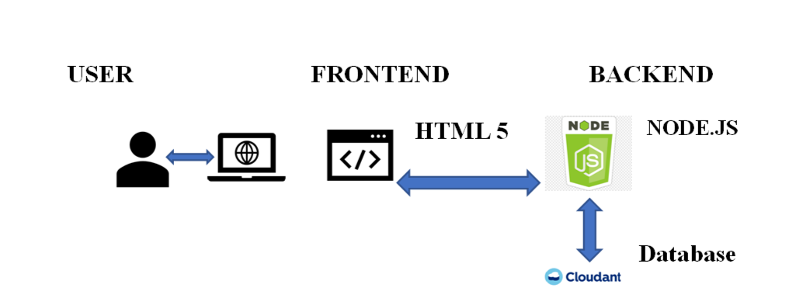

Slide 8
System Deployment Approach
The deployment approach for a movie application website involves a systematic process to make the site accessible to users. Initially, developers create the website using technologies like HTML, CSS, and JavaScript. Once the development phase is complete, the website is typically tested on development servers to identify and fix any issues. After thorough testing, the site is deployed onto production servers, ensuring high availability and scalability. Deployment can be achieved using various methods, such as manual uploads or automated Continuous Integration/Continuous Deployment (CI/CD) pipelines. Continuous monitoring and updates are essential to maintain website performance and security, and it may involve load balancing, content delivery networks (CDNs), and other optimization techniques to ensure a smooth user experience.

Slide 9
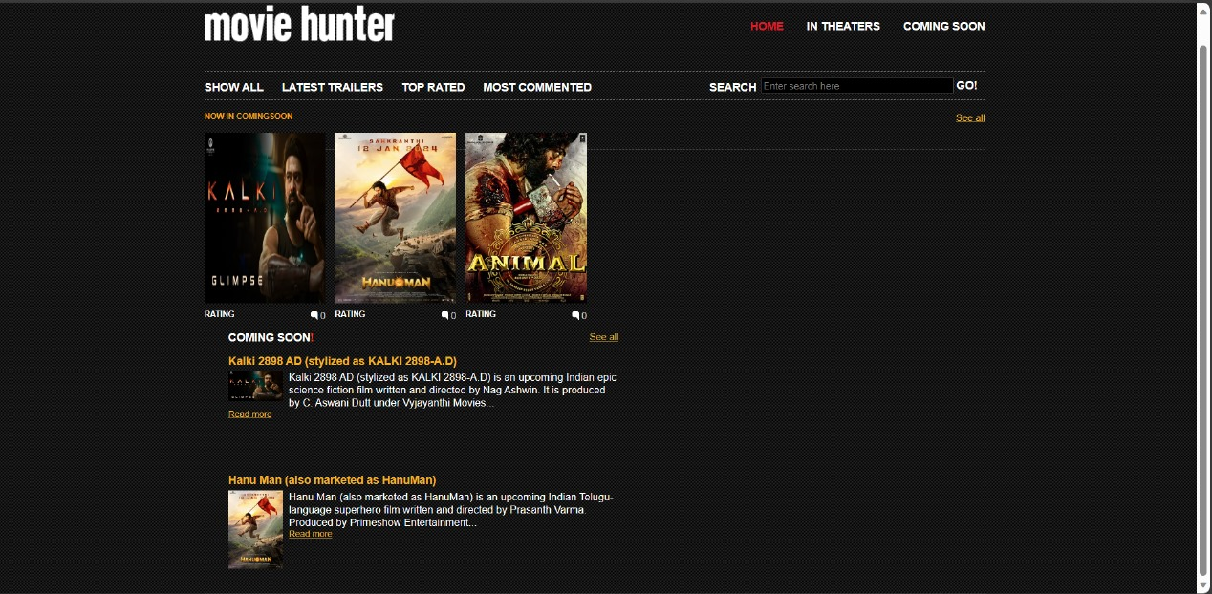
OUTPUT

Slide 10
Algorithm & Deployment
The deployment of a movie application website involves a series of steps to make the platform accessible to users. Initially, developers create the website using technologies like HTML, CSS, and JavaScript, integrating features such as movie databases, user profiles, and search functionalities. Once development is complete, rigorous testing occurs on development servers to identify and resolve any issues. Following successful testing, the website is deployed onto production servers, ensuring they are secure, scalable, and configured for optimal performance. Deployment methods can vary, including manual uploads or automated Continuous Integration/Continuous Deployment (CI/CD) pipelines. Continuous monitoring and updates are crucial to maintain performance, security, and a seamless user experience, often involving load balancing and CDNs for optimization.

Slide 11
Conclusion
In conclusion, the Movie Application Website represents a dynamic and user-centric platform for movie enthusiasts. With its intuitive design, robust features, and extensive movie database, it aims to enhance the cinematic experience. This project promises an exciting future for film lovers, offering convenience and engagement in one accessible digital hub.

Slide 12
References
Certainly, here are more concise references for a movie application website project:
HTML and CSS Tutorials: W3Schools: https://www.w3schools.com/
JavaScript for Interactivity: JavaScript.info: https://javascript.info/
GITHUB LINK
https://github.com/linga-varaprasad/EDUNETMovieApplicationWebsite.git

Slide 13
Future Scope
The future scope of a movie application website can be expansive, with opportunities for growth and improvement. Here are some potential areas for future development and enhancement:
Internationalization and Localization:
Expanding the website to cater to a global audience by offering content in multiple languages and considering cultural preferences.
Personalization and Recommendation Systems:
Implementing advanced recommendation algorithms to suggest movies based on user preferences andviewing history, enhancing the user experience.
User Engagement Features:
Adding interactive features such as user-generated content, forums, and social media integration to foster a sense of community among movie enthusiasts.
Mobile Applications:
Developing dedicated mobile apps for iOS and Android devices to reach a broader audience and provide a seamless mobile experience.

Slide 14
THANK YOU

